Slide 1




My SQLite BootCamp with Python
Soumil Nitin Shah
Bachelor in Electronic Engineering
Master in Electrical Engineering
Master in Computer Engineering
Graduate Research and Teaching Assistant

Slide 2
What is SQLite
SQLite is a software library that provides a relational database management system. The lite in SQLite means light weight in terms of setup, database administration, and required resource.

Slide 3
SQLite has following features
Serverless
SQLite is self-contained means it requires minimal support from the operating system or external library
Zero-configuration
Because of the serverless architecture, you don’t need to “install” SQLite before using it. There is no server process that needs to be configured, started, and stopped
Notes:
Serverless Self-Contained SQLite is self-contained means it requires minimal support from the operating system or external library
Zero-configuration

Slide 4
Typical User
Database have wide variety of user !
Analysts
1. Marketing
2. Business
3. Sales
Technical People
Data Scientist
Software Engineers
Web Developers

Slide 5
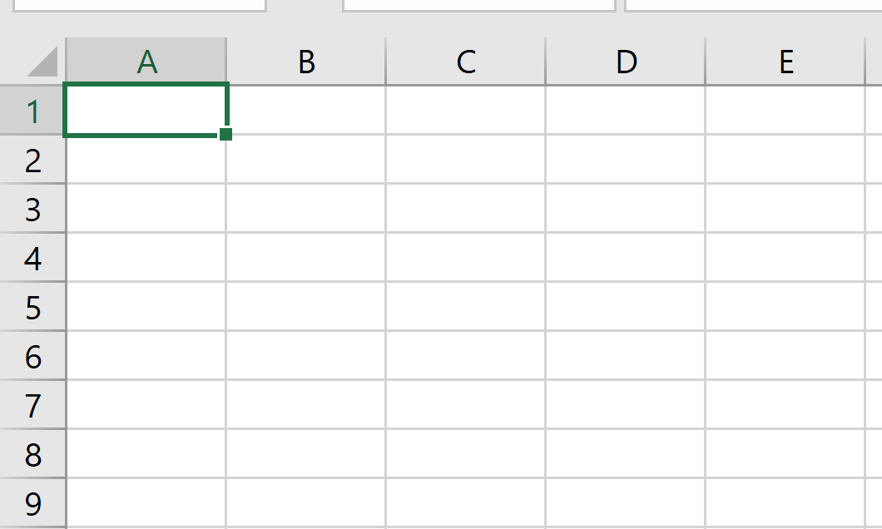
What is DataBase ?
In simple word Database can be thought of table that’s has several rows and columns.
You can imagine database to look much like Excel Spread Sheet shwown in Figure 1
Figure 1

Slide 6
Lets get started with Python and My Sqlite
We need to import the necessary library in order to use MySqlite with python. By default its already installed when you install python if not installed you can enter following command.
import sqlite3
Pip install MySqlite3

Slide 7
Establishing connection with Server
To Establish connection with database or to create a database we have to enter following command. Note if the database doesn’t exists if would automatically create database with that name
conn=sqlite3.connect("My_name.db")

Slide 8
Defining a Cursor
A cursor inDatabase can be thought of mouse or a pointer that is used to select the particular row or columns.
The Figure shown below in order to select the Row 1 and column A you have to move the mouse o that cell in order to edit that cell.
cursor=conn.cursor()

Slide 9
Executing a MySQL Command
Let us learn how to create a table in a database and name the columns
Following command creates a table with name table_name and we want two columns the name of column should be first_name and last_name
cursor.execute(""" CREATE TABLE IF NOT EXISTS name_table (first_name,last_name) """)

Slide 10
Commit and cursor close statements
After executing a sql statements you need to close connection you can do that by following commands.
Following commands shows its important to close a connection after use other CPU memory and processing is wasted its usually a good practice to write after the work is done
conn.commit() cursor.close() conn.close()

Slide 11
INSERT Statement
To insert data into a table, you use the INSERT statement
INSERT INTO table1 ( column1, column2 ,..) VALUES ( value1, value2 ,...);

Slide 12
WHERE Statement
The WHERE clause is an optional clause of the SELECT statement. It appears after the FROM clause as the following statement:
To pass variable we use ? And pass in the variable as shown below
cursor.execute(""" SELECT * FROM my_table_name WHERE first_name = "Soumil" """)
my_variable="soumil" cursor.execute(""" SELECT * FROM my_table_name WHERE first_name = ? """,(my_variable))
my_variable="soumil" cursor.execute(""" SELECT * FROM my_table_name WHERE first_name = ? """,(my_variable))

Slide 13
AND OR Statements
These statements are used to specify condition. Example shown below
my_first="soumil" my_last="Shah" cursor.execute(""" SELECT * FROM my_table_name WHERE first_name = ? AND last_name = ? """,(my_first,my_last))

Slide 14
UPDATE Statements
To update existing data in a table, you use SQLite UPDATE statement. The following illustrates the syntax of the UPDATE statement:
cursor.execute(""" UPDATE my_table_name SET column_name_1 = 22 WHERE column_name_1 = 2 """)

Slide 15
DELETE Statement
The SQLite DELETE statement allows you to delete one row, multiple rows, and all rows in a table. The syntax of the SQLite DELETE statement is as follows:
cursor.execute(""" DELETE my_table_name WHERE column_name_1 = 2 """)

Slide 16
COUNT Statement
SQLite COUNT is an aggregate function that returns the number of items in a group. For example, you can use the COUNT function to get the number of tracks, the number of artists, playlists and the number of tracks in each playlist, and so on
cursor.execute(""" SELECT COUNT (DISTINCT (column_name_1))\ FROM my_table_name """)

Slide 17
LIMIT Statements
The LIMIT clause is an optional part of the SELECT statement. You use the LIMIT clause to constrain the number of rows returned by the query.
For example, a SELECT statement returns one million rows. However, if you just need the first 10 rows in the result set, you add the LIMIT clause to the SELECT statement to get exact 10 rows.

Slide 18
Example of LIMIT Statement
my_first="soumil" my_last="Shah" cursor.execute(""" SELECT * FROM my_table_name WHERE first_name = ? AND last_name = ? LIMIT 5 """,(my_first,my_last))

Slide 19
SQLite stores rows in a table in an unspecified order. It means that the rows in the table may or may not be in the order that they were inserted.
If you use the SELECT statement to query data from a table, the order of rows in the result set is unspecified. To sort the result set, you add the ORDER BY clause in the SELECT statement as follows

Slide 20
Example of ORDER BY
my_first="soumil" my_last="Shah" cursor.execute(""" SELECT * FROM my_table_name WHERE first_name = ? AND last_name = ? LIMIT 5 ORDER BY ASC """,(my_first,my_last))

Slide 21
IN Statements
The SQLite IN operator is used to determine whether a value matches any value in a list or a subquery. The syntax of the IN operator is as follows:
1 | expression [NOT] IN (value_list|subquery);

Slide 22
LIKE Statements (Pattern Matching)
Sometimes, you don’t know exactly the complete keyword that you want to query. For example, you may know that your most favorite song contains the word,elevator but you don’t know exactly the name.
To query data based on partial information, you use the SQLite LIKE operator in the WHERE clause of the SELECT statement as follows:
Two important stuff to remember is
% For Matching any Sequence
_ Underscore operator for matching any single character.

Slide 23
Example on LIKE Statements
S% means select everything in database from the column_name_1 starting with Letter S
%S means all first name whose ending letter has S
%S% means select all names with has Letter S in Between.
cursor.execute(""" SELECT * FROM my_table_name WHERE first_name LIKE 'S%' LIMIT 5 ORDER BY ASC """)

Slide 24
Aggregate Functions
These are function used to perform Mathematical Operations
MAX
MIN
AVG
SUM

Slide 25
AVG Statement
The AVG function is an aggregate function that calculates the average value of all non-NULL values within a group.
The following illustrates the syntax of the AVG function:
cursor.execute(""" SELECT AVG(amount) FROM my_table_name """)

Slide 26
AS Statement
AS statement allows us to rename the column an example is shown below
cursor.execute(""" SELECT payment AS my_payments FROM table_name """)

Slide 27
INNER JOIN Statement
In relational databases, data is often distributed in many related tables. A table is associated with another table using foreign keys.
To query data from multiple tables, you use INNER JOIN clause. The INNER JOIN clause combines columns from correlated tables.
Suppose you have two tables: A and B.
A has a1, a2, and f columns. B has b1, b2, and f column. The A table links to the B table using a foreign key column named f.
The following illustrates the syntax of the inner join clause:

Slide 28
Explanation Inner Join
For each row in the A table, the INNER JOIN clause compares the value of the f column with the value of the f column in the B table. If the value of the f column in the A table equals the value of the f column in the B table, it combines data from a1, a2, b1, b2, columns and includes this row in the result set.
SELECT a1, a2, b1, b2 FROM A INNER JOIN B on B.f = A.f;

Slide 29

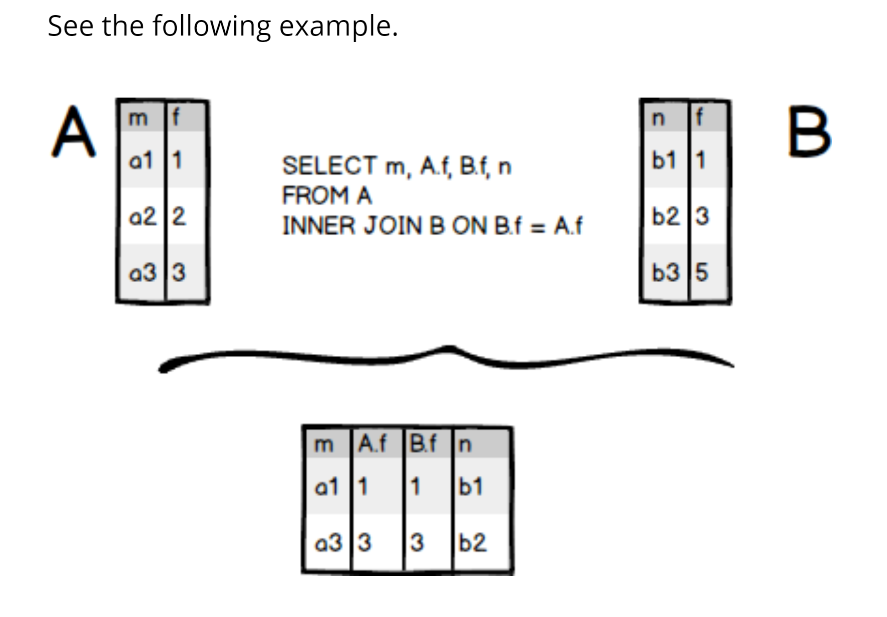
Explanation Inner Join
In other words, the INNER JOIN clause returns rows from the A table that has the corresponding row in B table.
This logic is applied if you join more than 2 tables

Slide 30
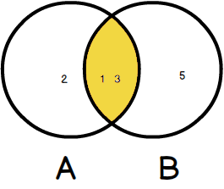
The following diagram illustrates the INNER JOIN clause:

Slide 31

Ven Diagram of Inner Join

Slide 32
CREATE Statement
To create a new table in SQLite, you use CREATE TABLE statement using the following syntax
CREATE TABLE [IF NOT EXISTS] table_name ( column_1 data_type PRIMARY KEY, column_2 data_type NOT NULL, column_3 data_type DEFAULT 0, table_constraint ) ;

Slide 33
CREATE Statement
The name of the table: you are not allowed to create a table with the name starting with sqlite_ because these names are reserved for SQLite’s internal use. In addition, you cannot create a table that already exists in the current database. To avoid this, you can use an optional clause IF NOT EXISTS to instruct SQLite to create a new table if the table does not exist, otherwise, just ignore the statement.

Slide 34
The name of each column, its data type, and an optional constraint. SQLite supports PRIMARY KEY, UNIQUE, NOT NULL, and CHECK constraints
The primary key of the table: is a column or a group of columns that uniquely identifies a row in the table. In case the primary key consists of multiple columns, you need to use table constraint instead of PRIMARY KEY column constraint.

Slide 35
CREATE TABLE contacts ( contact_id INTEGER PRIMARY KEY, first_name TEXT NOT NULL, last_name TEXT NOT NULL, email text NOT NULL UNIQUE, phone text NOT NULL UNIQUE )

Slide 36
The contact_id is the primary key of the contacts table
The first_name and last_name columns have TEXT storage class and those columns are NOT NULL. It means you must provide values when you insert or update rows in the contacts table
The email and phone are unique therefore you use the UNIQUE constraint for each column

Slide 37
Subquery
A subquery is a SELECT statement nested in another statement. See the following statement
You must use a pair of parentheses to enclose a subquery. Note that you can nest a subquery inside another subquery with a certain depth. .
SELECT column_1 FROM table_1 WHERE column_1 = (SELECT column_1 FROM table_2);

Slide 38
Thanks
Hope you enjoyed learning MYSqlite with python
If you have any question please ask your questions now.
Send me feedback on soushah@my.Bridgeport.edu

